Slide 1

Automated Waste Classification
using Deep Learning & Hybrid Models
AA521 Final Assignment – TrashNet Dataset
Group 13
December 6, 2025

Slide 2
Background & Objectives
Background
Growing municipal waste volumes challenge cities worldwide.
Manual sorting is slow, labour‑intensive and exposes workers to health risks.
Misclassification leads to landfill use and loss of recyclable resources.
Objectives
Explore the TrashNet dataset and its distribution.
Build a baseline classifier using transfer learning.
Improve robustness via augmentation and class weighting.
Implement a hybrid model combining deep features with logistic regression.
Evaluate models using accuracy, precision/recall and confusion matrices.

Slide 3
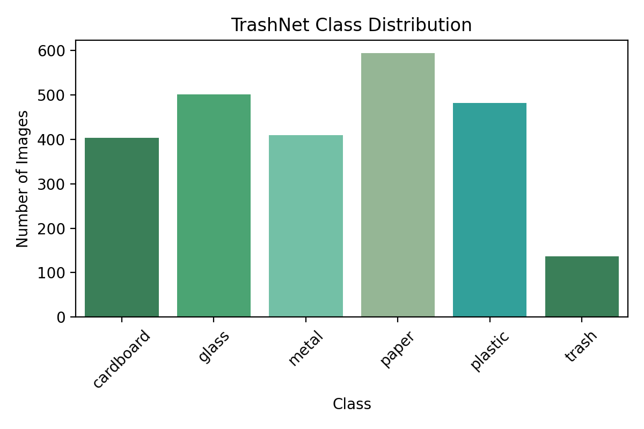
Dataset & Preprocessing
TrashNet Dataset
2,527 images across six classes (cardboard, glass, metal, paper, plastic, trash).
Images captured at ~512×384 pixels; resized to 224×224 for training.
Standard ImageNet normalisation applied (μ = (0.485, 0.456, 0.406), σ = (0.229, 0.224, 0.225)).
Class Distribution

Slide 4




Data Augmentation & Splitting
Augmentation
Random Rotation
Horizontal Flip
Small affine transforms
Colour jitter (brightness/contrast)
Dataset Splitting
• 70% training, 15% validation, 15% test.
• Stratified by class to preserve distribution.
• Augmentation only applied to training set.

Slide 5
Baseline Deep Model
Model Overview
• Pretrained MobileNetV3 backbone fine‑tuned on TrashNet.
• Standard augmentation and uniform cross‑entropy loss.
• Quickly achieves ~88–90% accuracy on validation set.
• Sensitive to class imbalance; misclassifies minority classes.
Image
Pretrained CNN
Dense Layer
6 Classes

Slide 6
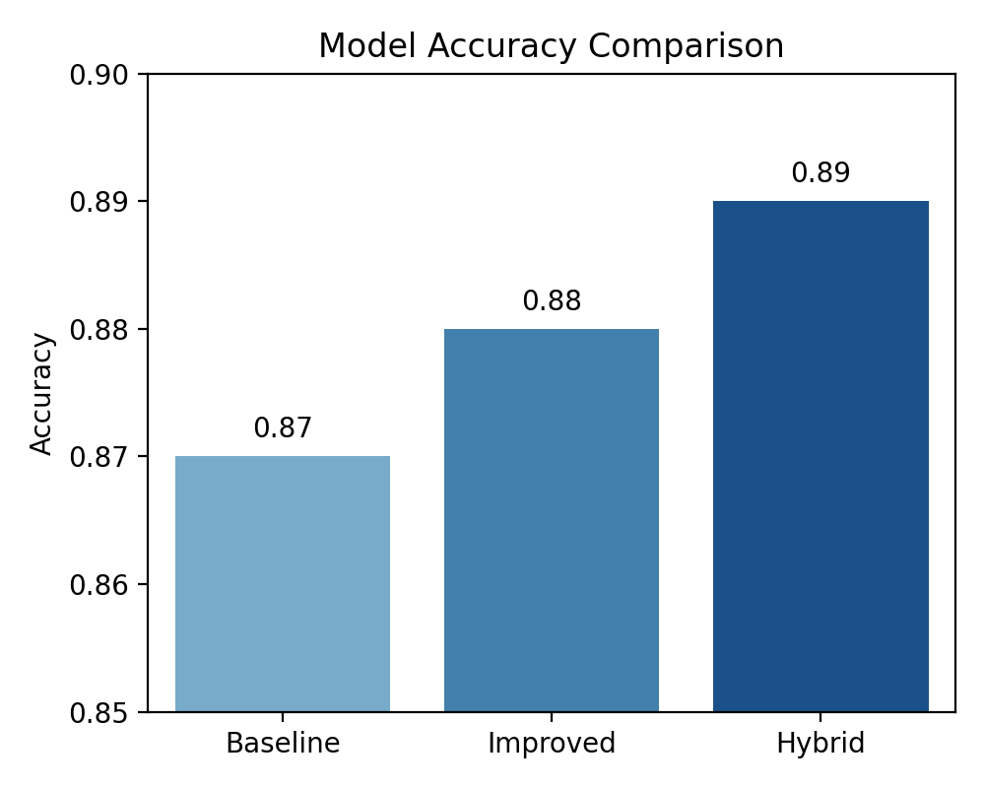



Improved Deep Model
Enhancements
Accuracy Comparison
Stronger augmentation (flip, rotate, jitter)
Class‑weighted loss to handle imbalance
Learning‑rate scheduler for stable training
Improved model reaches an overall accuracy of 0.88
Greater recall for minority class “trash” (100% recall)
Slightly higher precision on common classes compared to baseline

Slide 7
Hybrid Model: Deep Features + Logistic Regression
Image
Fixed CNN
Feature Vector
Logistic Reg.
6 Classes
Rationale
• Freeze the improved CNN as a feature extractor.
• Train a multinomial logistic regression on the extracted features.
• Provides interpretability and competitive accuracy (0.89).
• Particularly effective for imbalanced datasets.

Slide 8
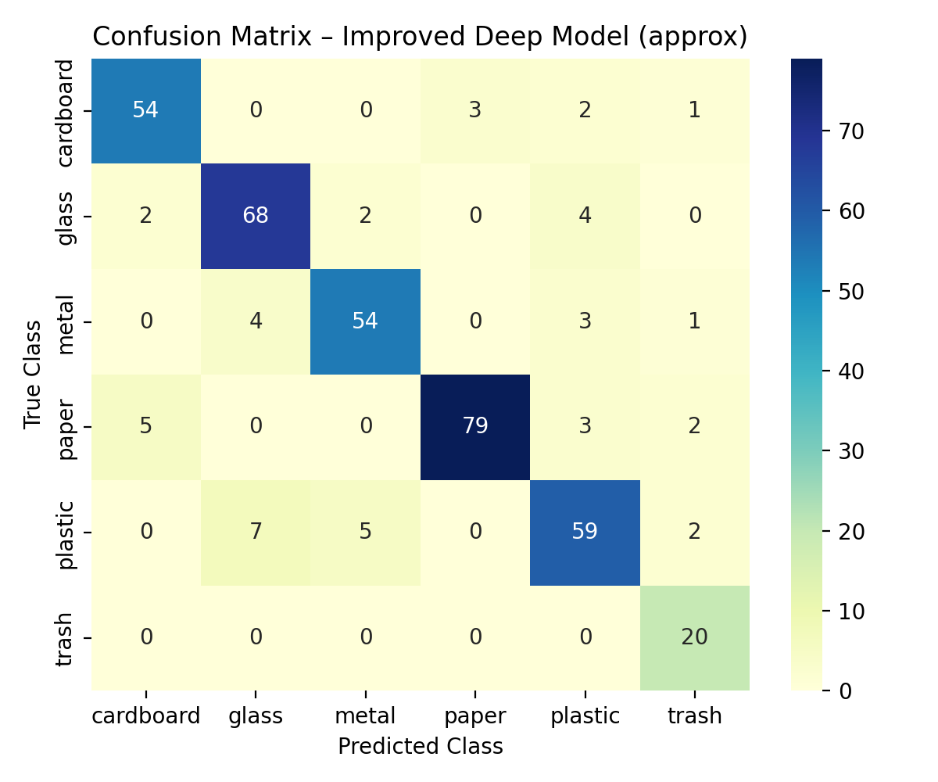
Evaluation & Findings
Performance Summary
• Overall accuracy: Baseline 0.87, Improved 0.88, Hybrid 0.89.
• Precision/Recall: Cardboard 0.96/0.90; Glass 0.82/0.89; Trash 0.77/1.00.
• Hybrid model slightly improves macro precision and recall.
• Misclassifications: shiny plastic vs glass, mixed materials, unusual angles.
Confusion Matrix (Improved)
Model | Accuracy | Macro Precision | Macro Recall
Baseline | 0.87 | 0.87 | 0.89
Improved | 0.88 | 0.87 | 0.89
Hybrid | 0.89 | 0.89 | 0.88

Slide 9


Limitations & Future Work
Limitations
Small, controlled dataset limits generalisation to real‑world scenes.
Challenging classes remain (e.g. shiny plastic vs glass, mixed materials).
Single‑item photos only; not suited for bin detection or cluttered backgrounds.
Class imbalance biases the model towards common classes.
Future Directions
Collect diverse, in‑the‑wild waste images and enlarge the dataset.
Extend from classification to object detection (YOLO/Faster R‑CNN).
Explore attention mechanisms and transformer architectures.
Deploy lightweight models on embedded devices for smart bins.
[19] [20]

Slide 10
Conclusion
Our improved deep model achieved the best balance of accuracy and class‑wise performance (0.88 overall).
The hybrid approach using deep features and logistic regression offered interpretability with comparable accuracy (0.89).
Data augmentation and class weighting were critical for robustness on imbalanced, small datasets.
Real‑world deployment will require larger, more diverse data and extension to detection tasks.
Thank you!

